Slide 1



BOMCA 10 2. Call for Proposals
1. Information Session

Slide 2
Agenda
Introduction & Timeline
Technical part
Administrative part
Q&A

Slide 3




Important Note
This presentation has been prepared for information purposes for potential grant beneficiaries.
In case of any conflict between this presentation and the grant guidelines and its annexes, the English Grant Applicant Guidelines and its Annexes will be binding.
To ensure equal treatment of applicants, the contracting authority cannot give a prior opinion on the eligibility of lead applicants, co-applicants, an action or specific activities.

Slide 4
Timeline
1. Online information session for interested organisations | 24th October 2023 11:00h Vienna local time
2. Deadline for requesting any clarifications from the Contracting Authority | 5th November 2023
3. Last date on which clarifications are issued by the Contracting Authority | 12th November 2023
4. Deadline for submission of applications | 19th November 2023 17:00h Vienna local time
5. Administrative and eligibility check (indicative) | November-December 2023
6. Evaluation Committee meetings (indicative) | November - December 2023
7. Signature of Grant Contract (indicative) | January 2024

Slide 5
Technical part - Objectives of the Call
The 2nd Call for Proposals is released as part of the BOMCA 10 Component 4 aimed at the improvement of cross-border cooperation for better living conditions in border areas through local economic development, with a focus on human rights, gender equality and support to vulnerable groups.
Amplifying the achievements of the projects that received grants within the 1st Call for Proposals, as well as acknowledging an important role played by non-profit organisations in supporting border communities in Central Asia, BOMCA 10 will provide grants for the implementation of non-profit organizations actions in the border areas.

Slide 6
Technical part - Objectives of the Call
General objective: To support engagement of non-profit organizations working in the border areas of the Central Asian states in implementation of initiatives for the benefit of the border communities.
Specific Objective: To support engagement of non-profit organizations working in the border regions within Central Asia in implementation of initiatives for the benefit of the Central Asian border communities by awarding them with funding.

Slide 7
Priority areas
    Research and analysis in the area of migration, cross-border and related areas;
    Awareness raising on irregular migration and trafficking in human beings’ prevention, as well as on issues of concern for the population affected by migration;
    Assistance to vulnerable groups of the population affected by migration and border proximity (in particular to children and women left behind by migrants);
    Support to entrepreneurship, including social entrepreneurship initiatives, of all groups of the population and among women, as a special category.
    Facilitation of CSOs and NGOs working in the border regions networks and forums for discussing and cooperating in migration and cross border areas.
  Although the list above is not exhaustive, i.e. other socially focused initiative are also eligible for support; action proposals targeting above-mentioned areas will be positively assessed during the evaluation stage in the relevance section.

Slide 8
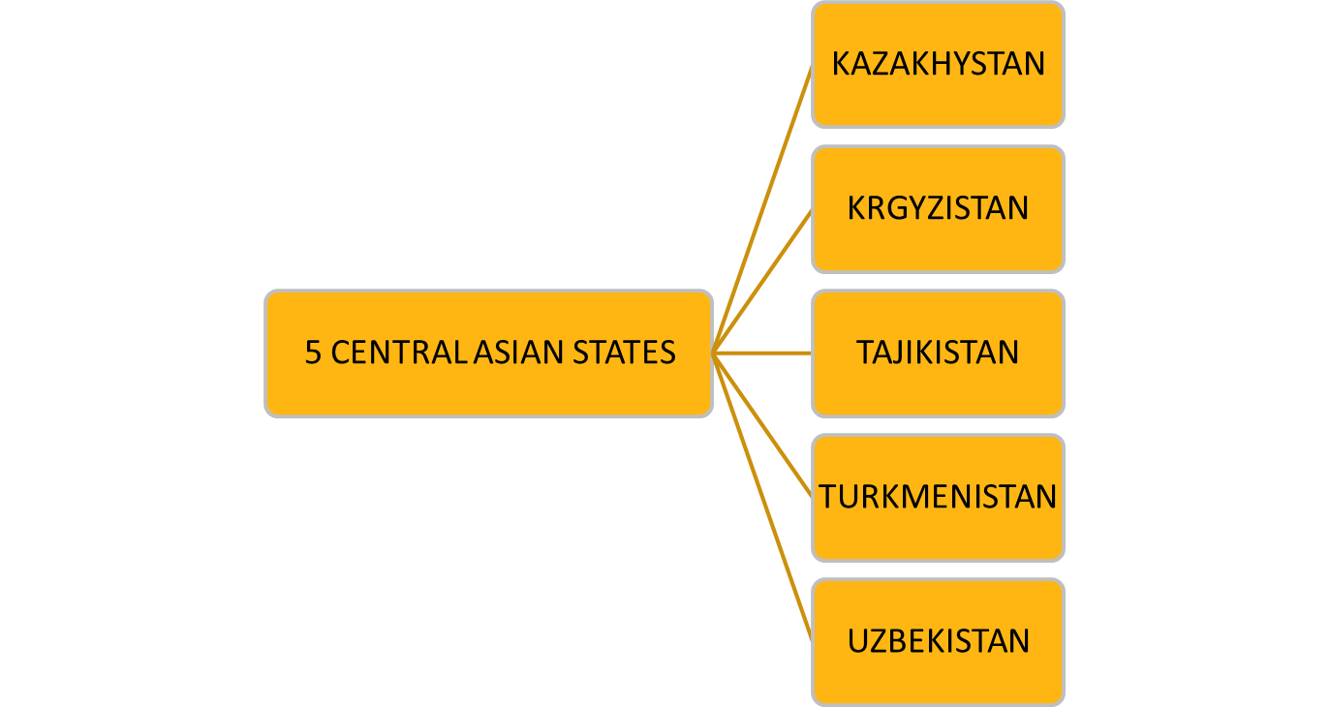
Scope of actions
Applications shall benefit the population residing in at least one border area of the five Central Asian states:

Slide 9
Border areas of 5 Central Asian states:
KAZAKHSTAN
Mangystau region
Aktobe region
KYRGZSTAN
Jalal-Abad region
Batken region
TAJIKISTAN
Khatlon region
Sughd region
TURKMENISTAN
UZBEKISTAN
Kyzylorda region
Turkistan region
Jambyl region
Almaty region
Osh region
Chui region
Issyk-Kul region
Talas region
Gorno-Badakhshan Autonomous Province
Balkan region
Daşoguz region
Mary region
Lebap region
Andijan region
Bukhara region
Fergana region
Jizzakh region
Khorezm region
Republic of Karakalpakstan
Namangan region
Navoiy region
Qashqadaryo region
Samarqand region
Sirdarya region
Surkhandarya region
Districts of the Republican subordination: Lakhsh district, Rasht district, Rudaki district, Shahrinav district, Tursunzoda district
Tashkent region
Applications that target other border areas of the Central Asian states, not listed above, will not be considered!

Slide 10
Scope of actions
The Actions can be implemented by a single non-profit organization or in a consortium of two or more Central Asian non-profit organizations jointly targeting a border area of a Central Asian state.
The Actions shall be based on specific, clear and achievable objectives, a realistic work plan and achievable timeline and measurable outputs/outcomes.
The Actions must be based on a clear sustainability analysis and demonstrate possibility of duration beyond the timeline of the action (e.g. complementarity with ongoing initiatives).
The following actions are particularly encouraged:
Initiatives, targeting more than one Central Asian state and submitted by non-profit organizations from two or more countries for the implementation in a cross-border context.
Initiatives, which are endorsed by or will be implemented in close cooperation with relevant local authorities of the Central Asian countries.

Slide 11
Agenda – Administrative part
Financial allocation
Eligibility criteria
Mandatory annexes and requested documents
Budget
Online application portal

Slide 12
Financial allocation provided by ICMPD
The overall indicative amount: EUR 660 000
The requested grant amount for actions shall be:
Minimum EUR 45 000;
Maximum EUR 55 000 in case of a sole Applicant i.e. single organisation applying for a grant;
Maximum EUR 60 000 in case Lead Applicant is applying together with one or more co-applicants.
Co-financing
ICMPD finances up to 100% of the total eligible cost of an action.
Co-financing is not a mandatory requirement.
Absence of co-financing shall be duly justified.

Slide 13
Eligibility of applicants I
In order to be eligible, the Lead Applicants must;
be legally registered in one of the Central Asian states (Kazakhstan, Kyrgyzstan, Tajikistan, Turkmenistan, and Uzbekistan);
be directly responsible for the preparation and management of the action, not acting as an intermediary;
be one of the following types of non-profit organisations: Civil society Organisation; Non-Governmental Organisation ; Public Association; Foundation; Research institution (public or private); and
  Applicants must have a legal status to operate and implement projects in the border areas of their respective countries (for the reference to the border regions, please, consult the Section Scope of actions).
Please note that grants will not be awarded to profit-making organisations!
*Non-governmental organisation is an organisation: i) which is independent of the state as regards to its establishment and appointment of its personnel and administrators, ii) which is a non-profit legal entity.

Slide 14
Eligibility of applicants II
Establishing cooperation with local authorities¹ (or local government organisations), as well as governmental institutions, foreseen in the implementation of the Action will be an asset, however, an application cannot be submitted by local authorities or governmental institutions themselves in any capacity (as an Applicant).
Co-applicants must satisfy the eligibility criteria as applicable to the Lead Applicant!
¹Here and throughout the Call for Proposals Guidelines, “local authorities” refer to public authorities at the decentralised level in the Central Asian border regions.

Slide 15
Eligibility of applicants III
Operational and financial capacity:
The applicants shall:
Have financial and operational capacity to undertake the proposed Action.
Have necessary professional competences and qualifications to complete proposed Action.

Slide 16
Eligibility of applicants III
Exclusion criteria
As a general principle, but in observance of the principle of proportionality, ICMPD shall exclude from participation applicants which were found in situations of:
bankruptcy, insolvency or winding-up procedures;
breach of obligations relating to the payment of taxes or social security contributions;
grave professional misconduct, including misrepresentation;
fraud;
corruption;
conduct related to a criminal organisation;
money laundering or terrorist financing;
terrorist offences or offences linked to terrorist activities;
child labour and other trafficking in human beings.

Slide 17
Eligibility of actions
General Criteria:
Duration: minimum 6 months & maximum 12 months.
Actions shall take place in the territory of at least one of the five Central Asian states and be targeted to make an impact in the border areas as defined in the section Scope of actions.
Actions shall take into account a risk assessment for implementation, including an assessment for the implications of Covid-19 pandemic and similar events.
Actions shall not involve activities that could harm the safety and security of beneficiaries, partners and organisations during implementations, or otherwise expose them to risks.
The objective of the Action shall not be commercial.
No grant may be awarded retroactively for Actions already completed.

Slide 18
Eligible activities (non-exhaustive list)
Organising and conducting research activities on migration and cross-border processes in the Central Asian region (with the focus on the border regions as defined in the Scope of actions Section of these Guidelines), as well as on the effects of migration processes on the border areas communities.
Developing and conducting awareness raising campaigns aimed at mitigating the risks of irregular migration and promoting safe and ordinary migration among the border areas communities, as well as targeting the groups of population affected by migration.

Slide 19
Eligible activities (non-exhaustive list)
Providing assistance to vulnerable groups of population residing in the border areas, especially women and children left behind by migration.
Providing assistance to population residing in the border areas in developing their entrepreneurship skills, in particular targeting social entrepreneurship and women led initiatives.
Organising capacity development activities for stakeholders to raise their awareness on migration and cross-border issues.

Slide 20
Eligibility of costs I
Only ‘eligible costs’ can be covered by a grant. Criteria for costs to be eligible are stated in the Call for Proposals Guidelines.
The budget is both a cost estimate and an overall ceiling for ‘eligible costs’.
Types of eligible costs
Direct costs:
the cost of staff assigned to the Action, corresponding to actual gross salaries including social security charges and other remuneration-related costs; salaries and costs shall not exceed those normally borne by the Beneficiary(ies), unless it is justified by showing that it is essential to carry out the Action;
local travel (within Central Asia) and subsistence costs for staff and other persons taking part in the Action, provided they do not exceed those normally borne by the Beneficiary(ies) nor the rates published by the European Commission at the time of such missions;

Slide 21
Eligibility of costs I
Types of eligible costs
Direct costs:
purchase costs for equipment and supplies (new or used) specifically for the purpose of the Action, provided that ownership is transferred at the end of the Action when required. Maximum threshold shall be 30% of the direct eligible costs;
depreciation, rental or leasing costs for equipment (new or used) and supplies specifically dedicated to the purposes of the action;
costs of consumables;
costs entailed by contracts awarded by the Beneficiary(ies) for the purposes of the Action;
costs deriving directly from the requirements of the Contract (dissemination of information, evaluation specific to the Action, audits, translation, reproduction, insurance, etc.) including financial service costs (in particular the cost of transfers and financial guarantees where required according to the Contract);

Slide 22
Eligibility of costs I
Types of eligible costs
Direct costs:
duties, taxes and charges, including VAT, paid and not recoverable by the Beneficiary(ies), unless otherwise provided in the Special Conditions;
project office costs or a portion of these when used for the action.
Costs actually incurred in relation to a project office used for the action or a portion of these costs may be accepted as eligible direct costs if the description of the project office, the services or resources it makes available, its overall capacity and (where applicable) the distribution key are provided in the Description of the Action and the Budget.

Slide 23
Eligibility of costs I
Indirect costs:
Indirect costs are those eligible costs which may not be identified as specific costs directly linked to the implementation of the action and may not be booked to it directly according to the conditions of eligibility. However, they are incurred by the Beneficiary(ies) in connection with the eligible direct costs for the Action. They may not include ineligible costs or costs already declared under another costs item or heading of the budget of this Contract.
The indirect costs incurred in carrying out the action may be eligible for flat-rate funding, but the total must not exceed 7% of the estimated total eligible direct costs.
The applicant(s) may be asked to justify the percentage requested before the Grant Contract is signed. However, once the flat rate has been fixed in the special conditions of the grant contract, no supporting documents need to be provided.

Slide 24
Eligibility of costs II
Ineligible costs:
The following costs shall not be considered eligible:
debts and debt service charges (interest);
provisions for losses or potential future liabilities;
costs declared by the Beneficiary(ies) and financed by another action or work programme receiving an ICMPD grant or European Union grant (including through EDF);
purchases of land or buildings, except where necessary for the direct implementation of the Action, in which case ownership shall be transferred to the final beneficiaries and/or a local Beneficiary(ies), at the latest at the end of the Action, in accordance with Article 7.5;

Slide 25
Eligibility of costs II
Ineligible costs:
currency exchange losses;
credits to third parties, unless otherwise specified in the Special Conditions;
contributions in kind;
bonuses included in costs of staff;
Negative interest charged by banks or other financial institutions.
financial support to third parties;
international travel outside of Central Asia;
purchase of vehicles.

Slide 26
Mandatory annexes (Documents to be completed)
Annex A – Application Form
To be submitted in English or Russian.
If co-applicants included, mandates to be signed by co-applicants.
Annex B – Budget
To be submitted in English or Russian.
Annex C – Legal Entity Form
To be submitted in English (Complementary translation available).
To be provided by each of the applicants (i.e. by the lead applicant and (if any) by each co-applicant)
Annex D – Declaration on Honour
To be submitted in English (Complementary translation available).
To be provided by each of the applicants (i.e. by the lead applicant and (if any) by each co-applicant)
Note: Always use the standard templates available for donwload on the online application portal after registration!

Slide 27
Other mandatory requested documents
Statutes or articles of association
→ To be provided by lead applicant and co-applicants.
The lead applicant must provide an audit report produced by an approved external auditor where it is available, and always in cases where a statutory audit is required by EU or national law. That report shall certify the accounts for up to the last financial year available. In all other cases, the applicant shall provide a self-declaration signed by its authorized representative certifying the validity of its accounts for up to the last financial year available. .
→ To be provided by the lead applicant only.
A copy of the latest accounts (the profit and loss account or statement of revenues and expenses and the balance sheet for the last financial year for which the accounts have been closed) → To be provided by the lead applicant only.
Note: The documents in the national Central Asian languages shall be submitted along with the certified translation into English or Russian.

Slide 28
Budget
1. Human Resources | Salaries (gross salaries including social security charges and other related costs, local staff)
2. Travel | Per diems for missions/travel, Local transportation costs
3. Equipment and Supplies | Furniture, computer equipment costs, costs for machines, tools, costs for spare parts/equipment for machines (The total cost of equipment and supplies should not exceed the 30% of the total eligible direct costs.)
4. Local Office | Vehicle rental costs, costs for office rent, costs for consumables, office supplies Costs for other services (tel/fax, electricity/heating, maintenance) (Budgeted project office costs (if applicable) must adequately reflect its use for the project)
5. Other Costs and Services | Publication, studies, research, evaluation costs, translation/interpreter costs, costs for financial services (bank guarantee costs, etc.), costs for conferences/seminars, visibility action costs
6. Other costs | Main activity costs are captured here
8. Contingency reserve | Max % 5 of subtotal of direct eligible costs of the Action
10. Indirect costs | Maximum 7% of total direct eligible costs of the Action

Slide 29
Online Application Portal: How to Register and Apply
To access the (In-tend) Call for Proposals Electronic Application Platform, visit:
https://in-tendhost.co.uk/icmpd/aspx/Tenders/Appraisal
Please check “How to Register and Apply Manual” which is available in English and Russian at:
https://in-tendhost.co.uk/icmpd/aspx/BuyerProfiles
No hard copies have to be submitted, applicants submit their applications through the portal only.

Slide 30
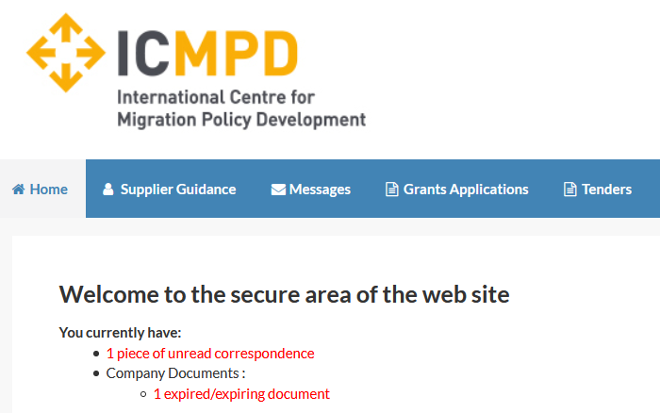
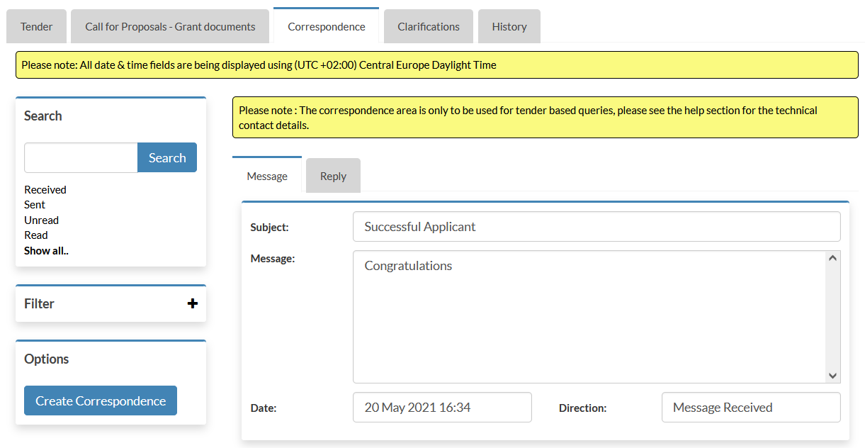
Online Application Portal: Communications
All communication with the applicants is handled through the Correspondence and Clarifications functions of the portal.
When ICMPD sends you a correspondence message you will receive an automated email notification. The correspondence message can be accessed from three places (1, 2, 3).
3
1
2
29

Slide 31
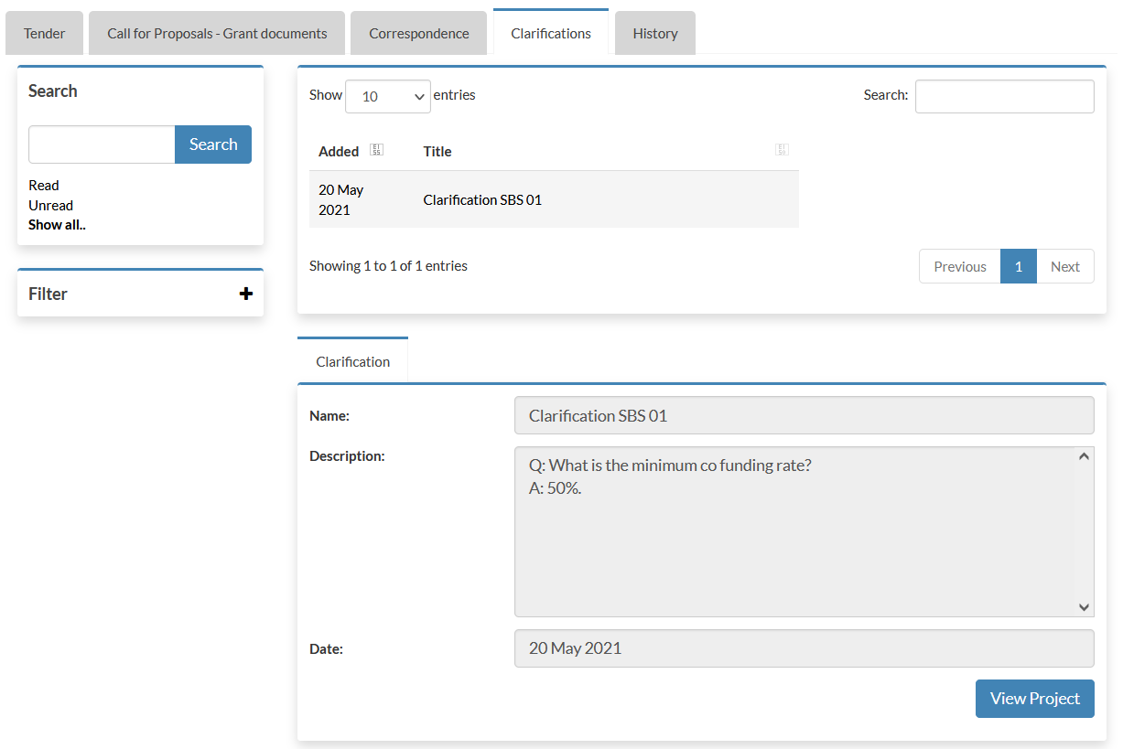
Online Application Portal: Clarifications issued by ICMPD
Clarifications may be published by ICMPD to inform all potential applicants of any material changes, missing information, or responses to clarifications questions that may have been received regarding the Call for Proposals.
If a clarification has been published then you will be notified via email and can access the new information under the Clarification (1) tab within the Call for Proposals management area of the project.
(1) The clarifications tab will give access to all clarifications issued for this Call for Proposals. Select the required clarification to view the information. A paper clip icon indicates a file attachment which can be accessed through the ‘Attachments Tab’.
Note: The clarification area of the portal is a one way messaging tool for ICMPD. Any questions relating to the content of a clarification should be made using the correspondence function.
1
30

Slide 32
Reminder
The deadline for the submission of applications is 19 November 2023, 17:00h (Vienna local time).
The lead applicant is strongly advised not to wait until the last day to submit its application, since heavy Internet traffic or a fault with the Internet connection (including electricity failure, etc.) could lead to difficulties in submission.
IMPORTANT!
Any application submitted after the deadline will automatically be rejected.

Slide 33
Best practice
Please check before submission:
  Do you satisfy eligibility requirements?
  Are all the requested documents attached?
  Have all documents been signed by all relevant parties?
Submit documents that are readable.
Finalize your application and submit before the deadline. Late submissions are non-compliant and will be rejected!
In case of doubt, use the clarification function on the online application portal.
Notes:
ICMPD/2023/2/BOMCA/CP4/CAS

Slide 34

Contact
grants@icmpd.org

Slide 35
Questions & Answers

