Slide 1



STREAMinG Phase II - Call for Proposals
1. Information Session

Slide 2
Agenda
Introduction & Timeline
Technical part
Administrative part
Q&A

Slide 3




Important Note
This presentation has been prepared for information purposes for potential grant beneficiaries.
In case of any conflict between this presentation and the grant guidelines and its annexes, the English Grant Applicant Guidelines and its Annexes will be binding.
To ensure equal treatment of applicants, the contracting authority cannot give a prior opinion on the eligibility of lead applicants, co-applicants, an action or specific activities.

Slide 4
Timeline
1. Online information session for interested organisations | 27 February 2024 11:00h Vienna local time
2. Deadline for requesting any clarifications from the Contracting Authority | 22 March 2024
3. Last date on which clarifications are issued by the Contracting Authority | 26 March 2024
4. Deadline for submission of applications | 04 April 2024 17:00h Vienna local time
5. Administrative and eligibility check | April - May 2024
6. Evaluation Committee meetings | April - May 2024
7. Signature of Grant Contract | June 2024
7. Latest possible end of implementation | June 2025

Slide 5
Technical part - Objectives of the Call
The 1st Call for Proposals is launched as part of Component 3 of the STREAMinG 2 project, with direct support from the European Union. The initiative aims to facilitate the reintegration of returning migrants, extend assistance to vulnerable members of local communities affected by migration, and advance women's empowerment through dedicated support from civil society organizations. Moreover, the initiative envisages strengthening the capabilities of Georgian CSOs, enhancing their involvement in migration policy dialogue and cooperation, fostering closer collaboration with local authorities, and encouraging increased engagement from Georgian diaspora organizations.

Slide 6
Technical part - Objectives of the Call
General objective:
To facilitate the dignified return and reintegration of returned Georgian migrants, support building more inclusive and resilient local communities affected by migration, while empowering civil society organizations to actively contribute to migration solutions and overall policy development.

Slide 7
Specific objectives
Priority areas:
    Support Vulnerable Communities: Extend assistance to individuals and groups at the local community level affected by migration, specifically addressing the challenges and needs of left-behind family members, encompassing children, women, and the elderly;
    Enhance Reintegration Awareness: Raise awareness among returned migrants about available reintegration services. Encourage their active participation in income-generating projects and other initiatives aimed at improving their skills for sustainable livelihoods;
    Foster Collaborative Networks: Establish networks between regional/local CSOs and Georgian diaspora organizations abroad. Focus on providing support initiatives for employment and entrepreneurship, contributing to the reintegration of returning Georgian migrants;

Slide 8
Priority areas
    Support Migrant Families: Implement initiatives to support households impacted by migration, with a specific emphasis on maximizing the economic impact of remittances. Develop targeted programmes that enhance financial literacy and promote investments to contribute to local economic development and household well-being.
    Empower Women in Migration: Promote and empower women through tailored initiatives addressing their specific concerns in the context of migration. Place special emphasis on rural areas, acknowledging that initiatives for women's empowerment can significantly influence community development.
  Applications must relate to at least one of the priority areas mentioned above. It is crucial that all projects consider gender equality and human rights protection as cross-cutting issues within their initiatives. The project design and outcome should also contribute to the overall development efforts in Georgia.

Slide 9
Scope of actions
Actions can be implemented by a consortium of a maximum of three organizations jointly undertaking a project. Diaspora organizations are encouraged to participate as co-applicants in these actions.
Applications must articulate Specific, Measurable, Achievable, Relevant, and Time-bound (SMART) objectives to ensure clarity and precision in project goals.
All actions must include a sustainability analysis, demonstrating the potential for continued impact beyond the action's timeline.
The following actions are particularly encouraged:
Initiatives that promote close collaboration with local authorities, private sector organisations, and diaspora organisations, along with cooperation projects and capacity-building activities.
Initiatives focusing on the promotion of gender equality and the empowerment of women, particularly in rural areas.
Initiatives implemented in the regions, outside of Tbilisi.

Slide 10
Agenda – Administrative part
Financial allocation
Eligibility criteria
Mandatory annexes and requested documents
Budget
Online application portal

Slide 11
Financial allocation provided by ICMPD
The overall indicative amount: EUR 200 000
The requested grant amount for actions shall be:
Minimum EUR 45 000;
Maximum EUR 50 000
Co-financing
ICMPD finances up to 100% of the total eligible cost of an action.
Co-financing is not a mandatory requirement.
Absence of co-financing shall be duly justified.

Slide 12
Eligibility of applicants I
In order to be eligible, the Lead Applicants must;
  be a legal person, and
  be directly responsible for the preparation and management of the action, with the co-applicants not acting as an intermediary.
  be a Non-Governmental Organisation*, and
  be established in Georgia in accordance with the legal requirements of the Government of Georgia.
A consortium of organizations is recommended. Consortia consisting of a maximum of three (3) applicants, i.e., the Lead applicant plus a maximum of 2 co-applicants, are eligible.
*Non-governmental organisation’ means a voluntary, independent from government, non-profit organisation, which is not a political party or a trade union.

Slide 13
Eligibility of applicants II
In order to be eligible, the Co-Applicants must;
  be a legal person, and
  be directly responsible for the preparation and management of the action, with the Lead-applicant not acting as an intermediary;
  be a Non-Governmental Organisation, and
  be established in Georgia in accordance with the legal requirements of the Government of Georgia, or;
  be diaspora organization* registered in one of the EU member states according to relevant national legislation.
  A consortium can only have one diaspora organization. Collaboration with local authorities (local government organizations) and private for-profit sector organizations in the action is recommended and highly encouraged. However, grants will not be provided to these entities.
  *Diaspora organisation is a community created in accordance with the legislation of the state of residence (Law of Georgia on Compatriots Residing Abroad and Diaspora Organisations)

Slide 14
Eligibility of applicants III
Operational and financial capacity:
The applicants shall:
Have financial and operational capacity to undertake the proposed Action.
Have necessary professional competences and qualifications to complete proposed Action.

Slide 15
Eligibility of applicants III
Exclusion criteria
As a general principle, but in observance of the principle of proportionality, ICMPD shall exclude from participation applicants which were found in situations of:
bankruptcy, insolvency or winding-up procedures;
breach of obligations relating to the payment of taxes or social security contributions;
grave professional misconduct, including misrepresentation;
fraud;
corruption;
conduct related to a criminal organisation;
money laundering or terrorist financing;
terrorist offences or offences linked to terrorist activities;
child labour and other trafficking in human beings.

Slide 16
Eligibility of actions
General Criteria:
Duration: minimum 10 months & maximum 12 months.
Actions shall be completed by 1 July 2025.
Actions shall take place in the territory of Georgia.
Actions shall not involve activities that could harm the safety and security of beneficiaries, partners and organisations during implementations, or otherwise expose them to risks (in any case, ICMPD shall not take any responsibility in this regard).
The objective of the Action shall not be commercial.
No grant may be awarded retroactively for Actions already completed.

Slide 17
Eligible activities (non-exhaustive list)
Conducting local outreach, awareness-raising, and advocacy campaigns, along with other communication and information provision activities.
Organizing roundtables, seminars, expert discussions, and similar events.
Conducting training sessions and workshops for beneficiaries of proposed projects (e.g., returned migrants, migrant households, left-behind family members, etc.), which include providing support in vocational education and fostering skill development and knowledge enhancement.
Providing advisory and consultancy services that encompass legal and psycho-social support, as well as offering direct medical assistance.

Slide 18
Eligible activities (non-exhaustive list)
Procuring small-scale goods and technical equipment to assist beneficiaries of proposed projects (e.g., returned migrants, migrant households, left-behind family members, etc.) in their economic activities or to support educational and medical facilities, among other purposes.
Creating collaboration frameworks to foster partnerships and enhance cooperative efforts.
Developing promotional materials, including videos and other public relations visibility assets.

Slide 19
Eligibility of costs I
Only 'eligible costs' can be covered by a grant. Criteria for costs to be eligible are stated in the Call for Proposals Guidelines.
The budget is both a cost estimate and an overall ceiling for 'eligible costs'.
Types of eligible costs
Direct costs:
the cost of staff assigned to the Action, corresponding to actual gross salaries including social security charges and other remuneration-related costs; salaries and costs shall not exceed those normally borne by the Beneficiary(ies), unless it is justified by showing that it is essential to carry out the Action;
travel and subsistence costs for staff and other persons taking part in the Action, provided they do not exceed those normally borne by the Beneficiary(ies) nor the rates published by the European Commission at the time of such missions;

Slide 20
Eligibility of costs I
Types of eligible costs
Direct costs:
purchase costs for equipment, other than vehicles, and supplies (new or used) specifically for the purpose of the Action, provided that ownership is transferred at the end of the Action when required.
depreciation, rental or leasing costs for equipment (new or used) and supplies specifically dedicated to the purposes of the action;
costs of consumables;
costs entailed by contracts awarded by the Beneficiary(ies) for the purposes of the Action;
costs deriving directly from the requirements of the Contract (dissemination of information, evaluation specific to the Action, audits, translation, reproduction, insurance, etc.) including financial service costs (in particular the cost of transfers and financial guarantees where required according to the Contract);

Slide 21
Eligibility of costs I
Types of eligible costs
Direct costs:
duties, taxes and charges, including VAT, paid and not recoverable by the Beneficiary(ies), unless otherwise provided in the Special Conditions.
project office costs or a portion of these when used for the action.
Costs actually incurred in relation to a project office used for the action or a portion of these costs may be accepted as eligible direct costs if the description of the project office, the services or resources it makes available, its overall capacity and (where applicable) the distribution key are provided in the Description of the Action and the Budget

Slide 22
Eligibility of costs I
Indirect costs:
Indirect costs are those eligible costs which may not be identified as specific costs directly linked to the implementation of the action and may not be booked to it directly according to the conditions of eligibility. However, they are incurred by the Beneficiary(ies) in connection with the eligible direct costs for the Action. They may not include ineligible costs or costs already declared under another costs item or heading of the budget of this Contract.
The indirect costs incurred in carrying out the action may be eligible for flat-rate funding, but the total must not exceed 7% of the estimated total eligible direct costs.
The applicant(s) may be asked to justify the percentage requested before the Grant Contract is signed. However, once the flat rate has been fixed in the special conditions of the grant contract, no supporting documents need to be provided.

Slide 23
Eligibility of costs II
Ineligible costs:
The following costs shall not be considered eligible:
debts and debt service charges (interest);
provisions for losses or potential future liabilities;
costs declared by the Beneficiary(ies) and financed by another action or work programme receiving an ICMPD grant or European Union grant (including through EDF);
purchases of land or buildings, except where necessary for the direct implementation of the Action, in which case ownership shall be transferred to the final beneficiaries and/or a local Beneficiary(ies), at the latest at the end of the Action;

Slide 24
Eligibility of costs II
Ineligible costs:
currency exchange losses;
credits to third parties, unless otherwise specified in the Special Conditions;
contributions in kind;
bonuses included in costs of staff;
Negative interest charged by banks or other financial institutions.
financial support to third parties;
purchase of vehicles.

Slide 25
Mandatory annexes (Documents to be completed)
Annex A – Application Form
To be submitted as a WORD file AND as a signed scanned version (PDF).
If co-applicants included, mandates to be signed by co-applicants.
Annex B – Budget
To be submitted as an EXCEL file AND as a signed scanned version (PDF).
Annex C – Legal Entity Form
To be submitted as a signed and scanned version (PDF).
To be provided by each of the applicants (i.e. by the lead applicant and (if any) by each co-applicant)
Annex D – Declaration on Honour
To be submitted as a signed and scanned version (PDF).
To be provided by each of the applicants (i.e. by the lead applicant and (if any) by each co-applicant)
Always use the standard templates available for donwload on the online application portal after registration!

Slide 26
Other mandatory requested documents
Statutes or articles of association
To be provided by lead applicant and co-applicants.
2. Audit report/self declaration: Audit report shall certify the accounts for up to the last financial year available. In all other cases, the applicant shall provide a self-declaration
To be provided by the lead applicant only.
Copy of the latest accounts: The profit and loss account/income statement and the balance sheet for the last financial year for which the accounts have been closed
To be provided by the lead applicant only.
The documents in the national language shall be submitted along with the certified translation into English!

Slide 27
Budget
1. Human Resources | Salaries (gross salaries including social security charges and other related costs, local staff)
2. Travel | Per diems for missions/travel, International travel, Local transportation costs
3. Equipment and Supplies | Furniture, computer equipment costs, costs for machines, tools, costs for spare parts/equipment for machines, tools
4. Local Office | Vehicle rental costs, costs for office rent, costs for consumables, office supplies Costs for other services (tel/fax, electricity/heating, maintenance) (Budgeted project office costs (if applicable) must adequately reflect its use for the project)
5. Other Costs and Services | Publication, studies, research, evaluation costs, translation/interpreter costs, costs for financial services (bank guarantee costs, etc.), costs for conferences/seminars, visibility action costs
6. Other costs | Other types of expenditures
8. Contingency reserve | Max % 5 of subtotal of direct eligible costs of the Action
10. Indirect costs | Maximum 7% of total direct eligible costs of the Action

Slide 28
Online Application Portal: How to Register and Apply
To access the (In-tend) Call for Proposals Electronic Application Platform, visit:
https://in-tendhost.co.uk/icmpd/aspx/Tenders/Appraisal
Please check “How to Register and Apply Manual” which is available in English and Russian at:
https://in-tendhost.co.uk/icmpd/aspx/BuyerProfiles
No hard copies have to be submitted; applicants submit their applications through the portal only.

Slide 29
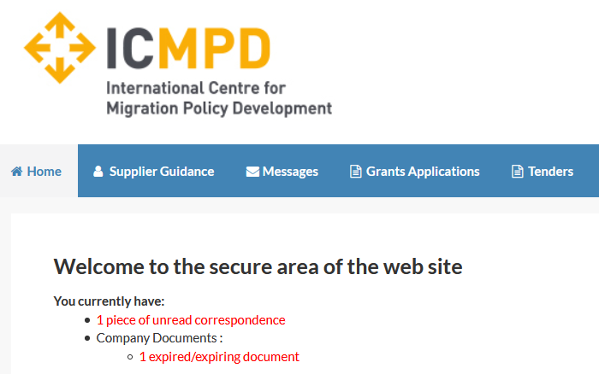
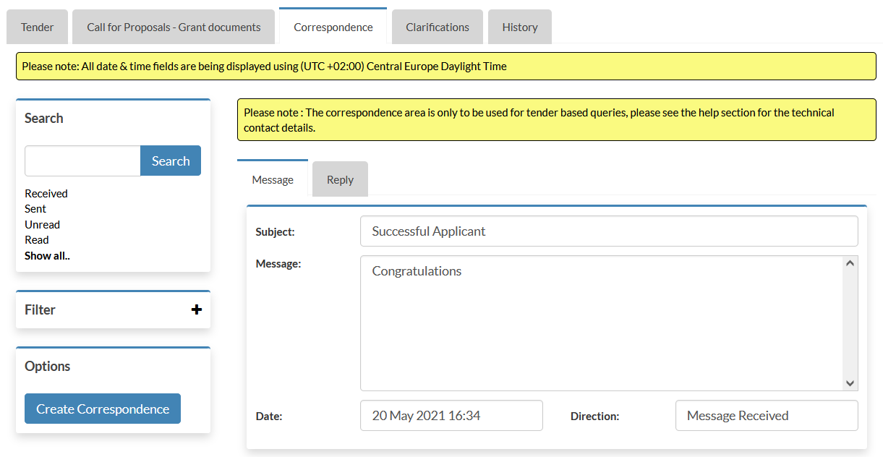
Online Application Portal: Communications
All communication with the applicants is handled through the Correspondence and Clarifications functions of the portal.
When ICMPD sends you a correspondence message you will receive an automated email notification. The correspondence message can be accessed from three places (1, 2, 3).
3
1
2
28

Slide 30
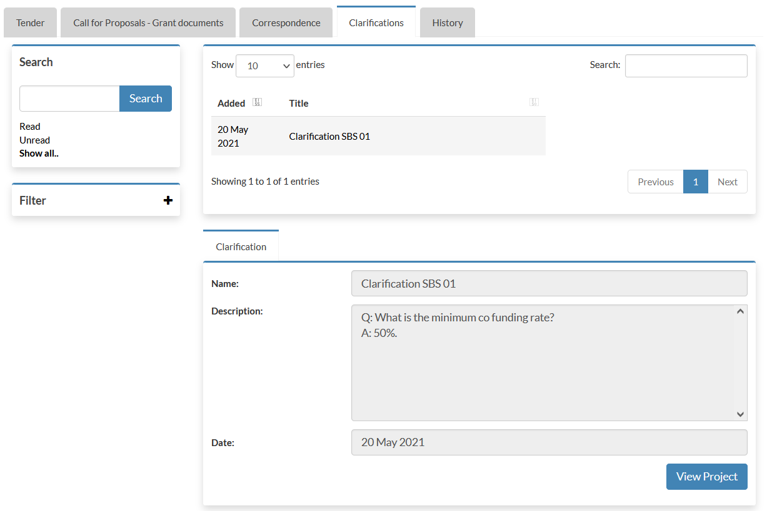
Online Application Portal: Clarifications issued by ICMPD
Clarifications may be published by ICMPD to inform all potential applicants of any material changes, missing information, or responses to clarifications questions that may have been received regarding the Call for Proposals.
If a clarification has been published then you will be notified via email and can access the new information under the Clarification (1) tab within the Call for Proposals management area of the project.
(1) The clarifications tab will give access to all clarifications issued for this Call for Proposals. Select the required clarification to view the information. A paper clip icon indicates a file attachment which can be accessed through the ‘Attachments Tab’.
Note: The clarification area of the portal is a one way messaging tool for ICMPD. Any questions relating to the content of a clarification should be made using the correspondence function.
1
29

Slide 31
Reminder
The deadline for the submission of applications is 04 April 2024, 17:00h (Vienna local time).
The lead applicant is strongly advised not to wait until the last day to submit its application, since heavy Internet traffic or a fault with the Internet connection (including electricity failure, etc.) could lead to difficulties in submission.
IMPORTANT!
Any application submitted after the deadline will automatically be rejected.

Slide 32
Best practice
Please check before submission:
  Do you satisfy eligibility requirements?
  Are all the requested documents attached?
  Have all documents been signed by all relevant parties?
Submit documents that are readable.
Finalize your application and submit before the deadline. Late submissions are non-compliant and will be rejected!
In case of doubt, use the clarification function on the online application portal.
Notes:
ICMPD/2023/2/BOMCA/CP4/CAS

Slide 33

Contact
grants@icmpd.org

Slide 34
Questions & Answers

